Slide 1



Syntax Squad
Mehul Pandey
Devika Sinha
G. Kirtika

Slide 2

 | Table of Content
1 | Introduction
2 | Objective
3 | Methodology
4 | Outcomes
5 | Frontend Development
6 | Conclusion
7 | Future Scope

Slide 3
Optimizing Road Connectivity in Rural Regions of India

Slide 4
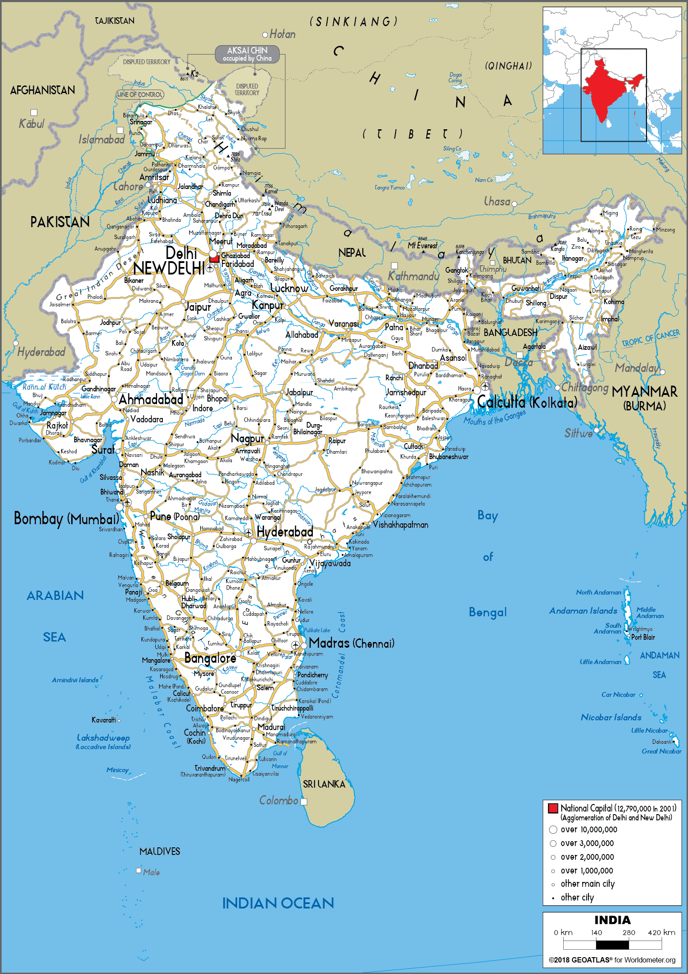
Introduction
Context and Challenges:
Road connectivity in rural and hilly India is essential for development but is hindered by geographic and logistical constraints.
Project Goals:
This project uses OpenStreetMap data and machine learning to improve road connectivity by identifying critical gaps and suggesting new road connections.

Slide 5
Objective
Highlight Areas where existing road requires upgrades or maintenance.
Identify region where new roads are needed.
Optimize road planning to improve connectivity most cost-effectively.

Slide 6
Dataset collection
USGS Earth Explorer & OpenSatelliteMap
Python , OSMnx, Rasterio, geopandas, Folium
Focus Area
Library / Tools used

Slide 7
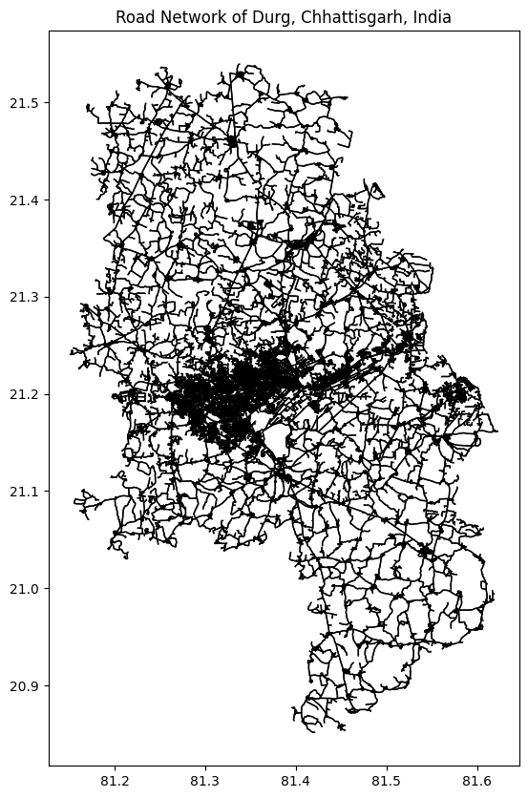
Methodology
Imported data from OSMnx.
Applied Statistical description survey
Performed EDA

Slide 8
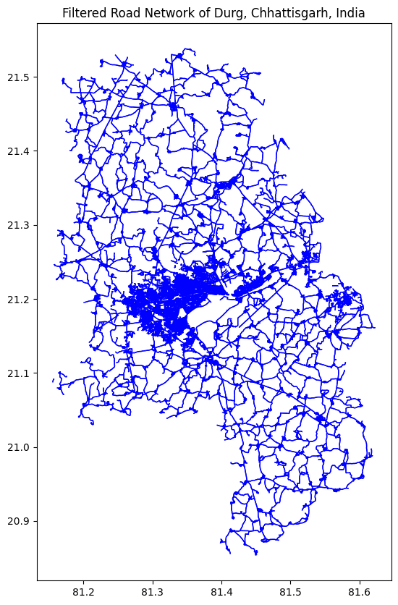
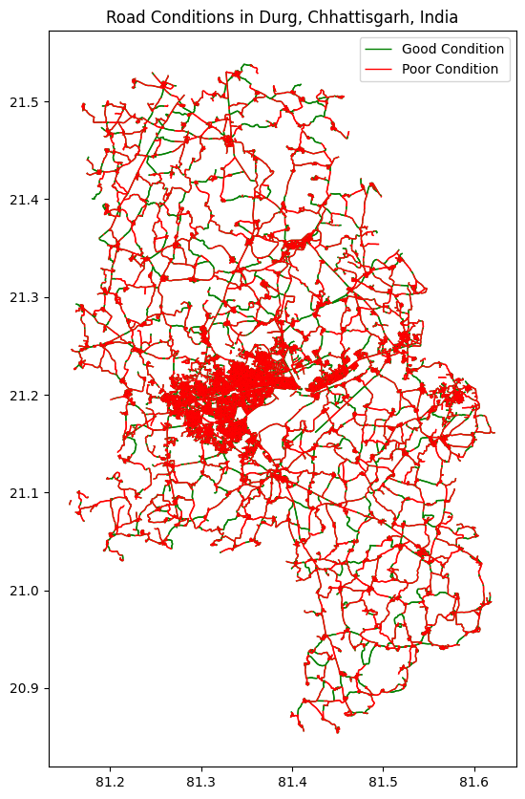
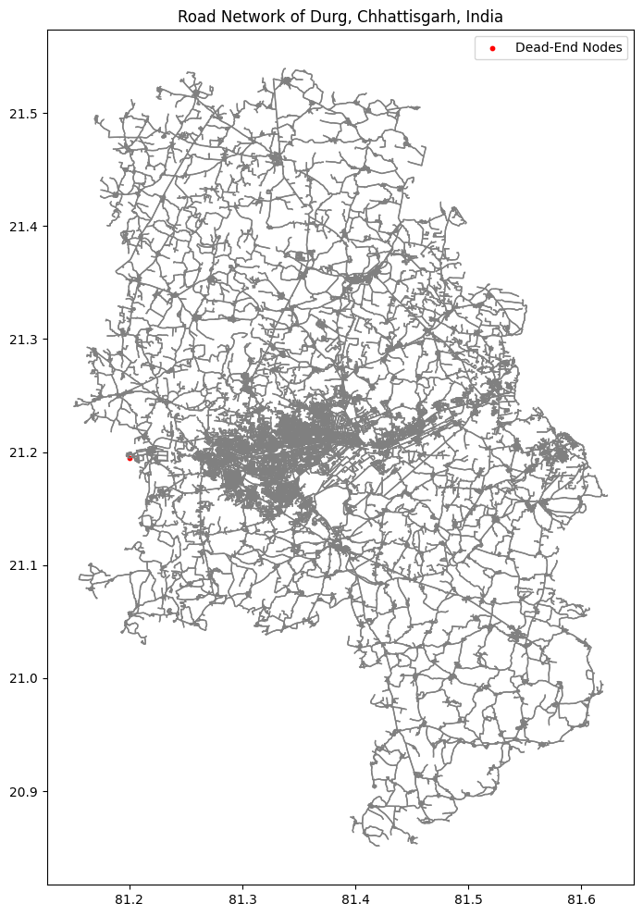
Filtered Road network based on different criteria’s
Done analysis of Good condition and bad condition road
Found paths that have dead ends and isolation points

Slide 9
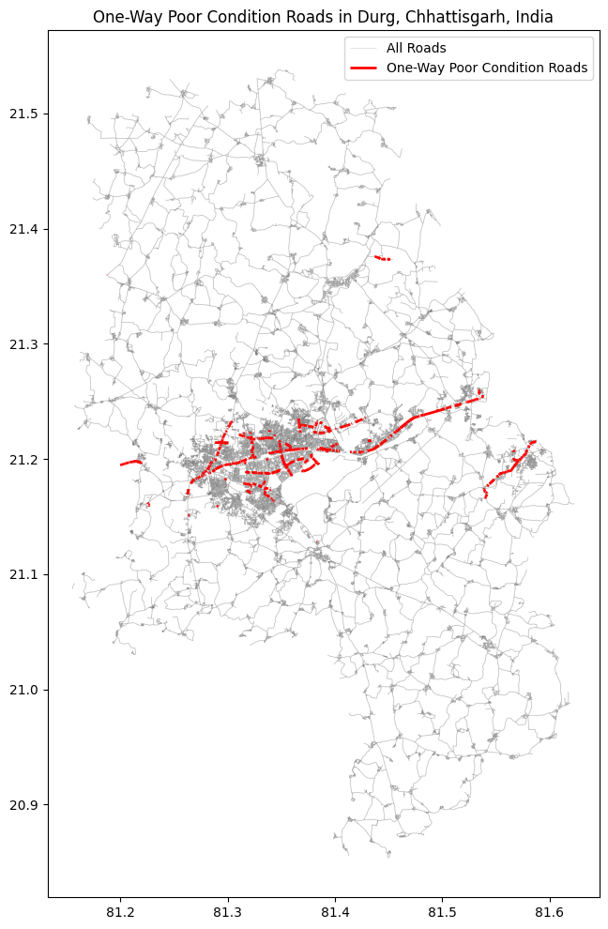
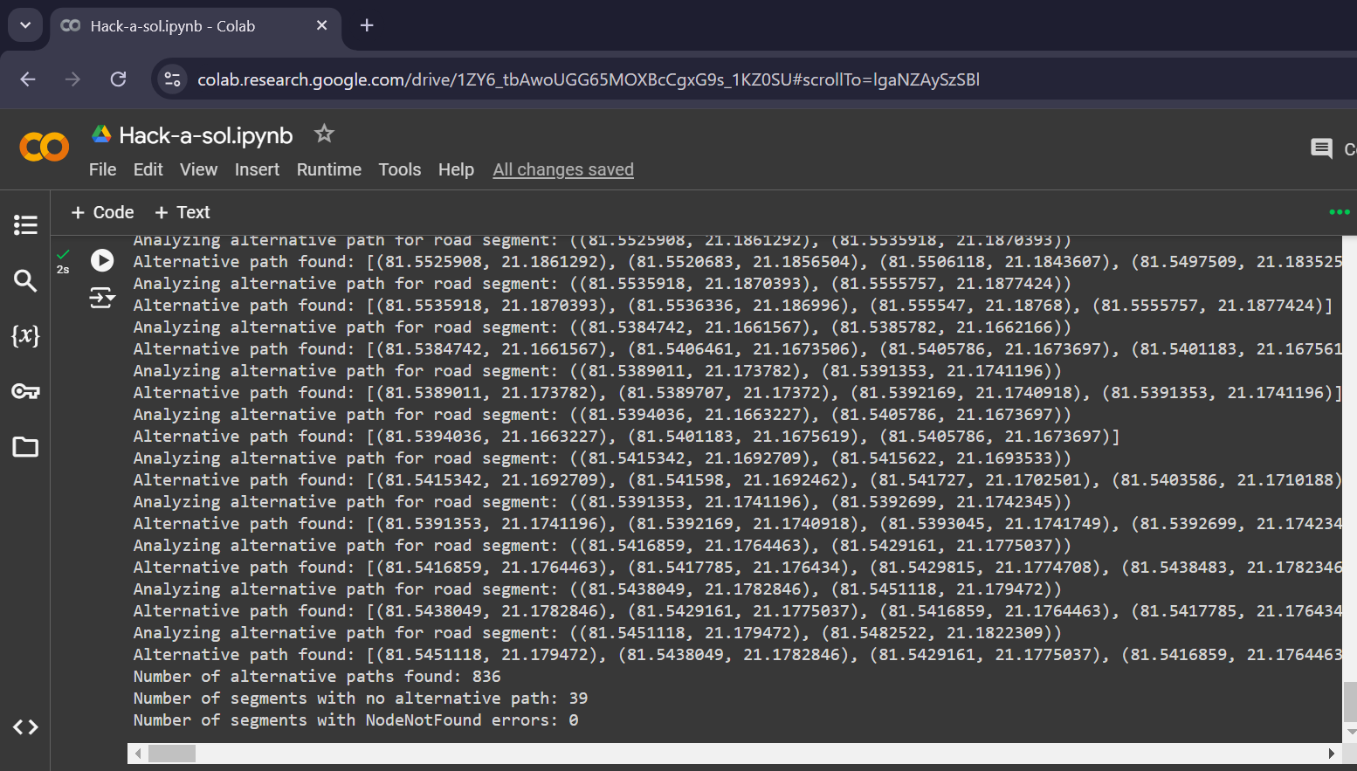
Paths having one-way and poor condition roads
Illustrates a one-way road in poor condition within the road network.
Emphasizes areas needing infrastructure improvements.
Aids in identifying critical segments for enhancing overall network efficiency.
Highlights limited connectivity and suboptimal attributes of the road.

Slide 10
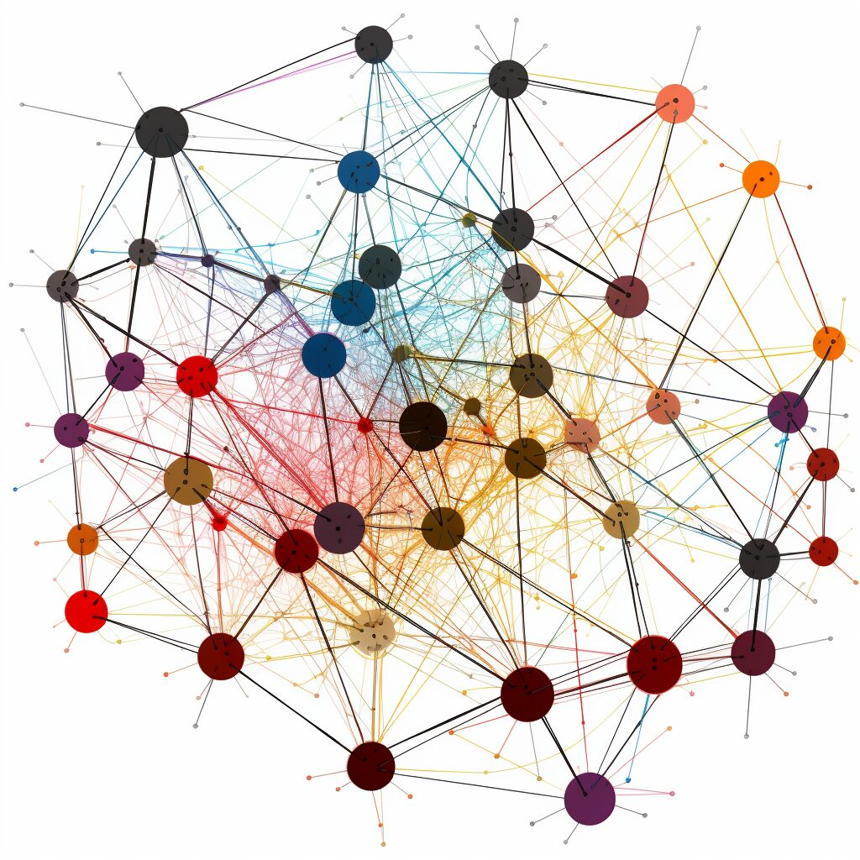
Dijkstra Algorithm
Dijkstra's Algorithm: To find optimal paths and propose new road connections, Dijkstra's algorithm calculates the shortest paths between nodes, effectively addressing connectivity gaps.
The algorithm has been applied to one-way poor conditions road data to make it goes from 1 node to another without using any poor condition roads.

Slide 11
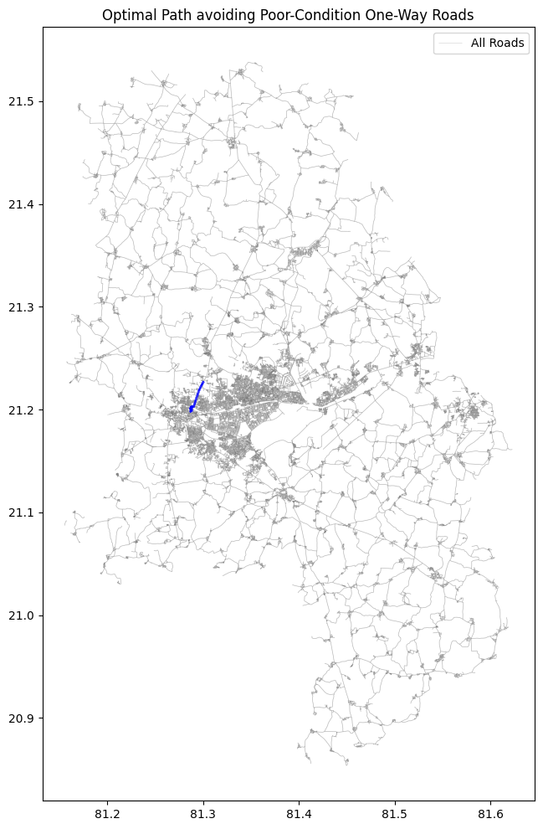
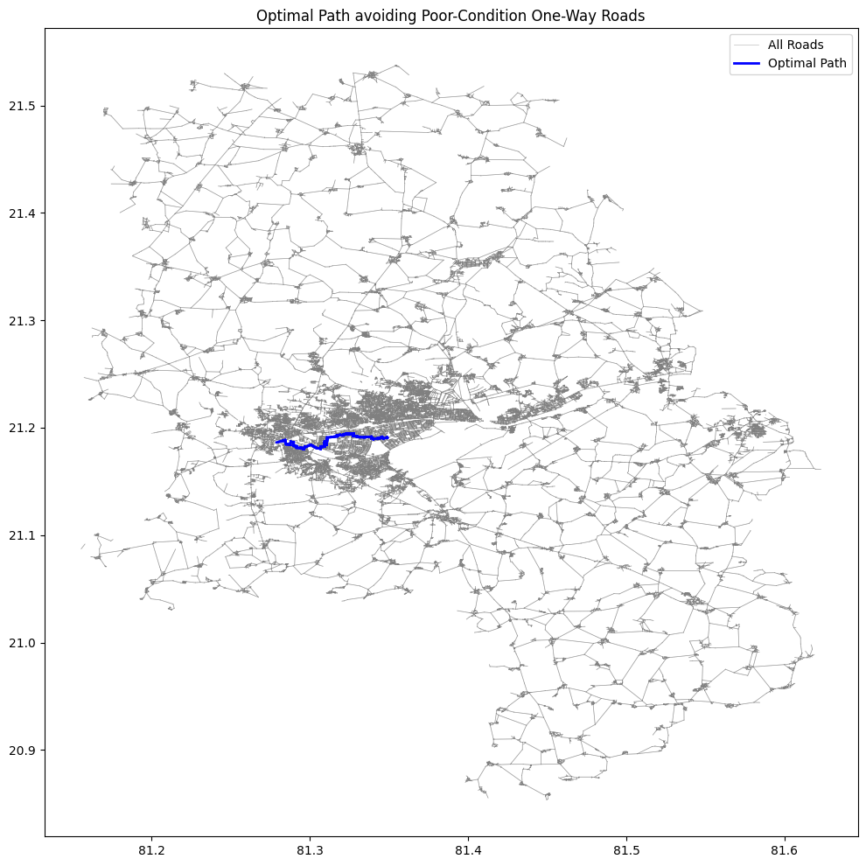
Final Optimal Path Route

Slide 12
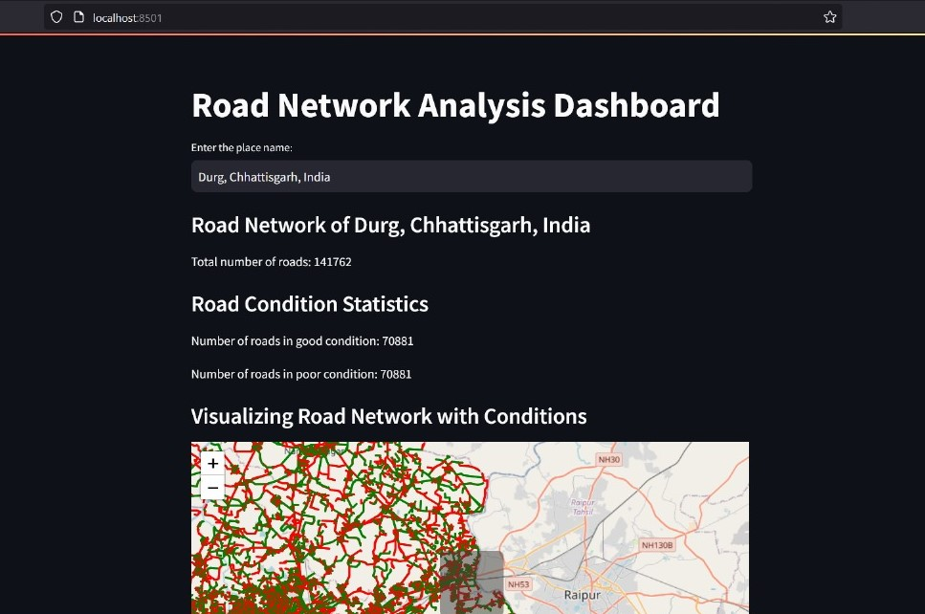
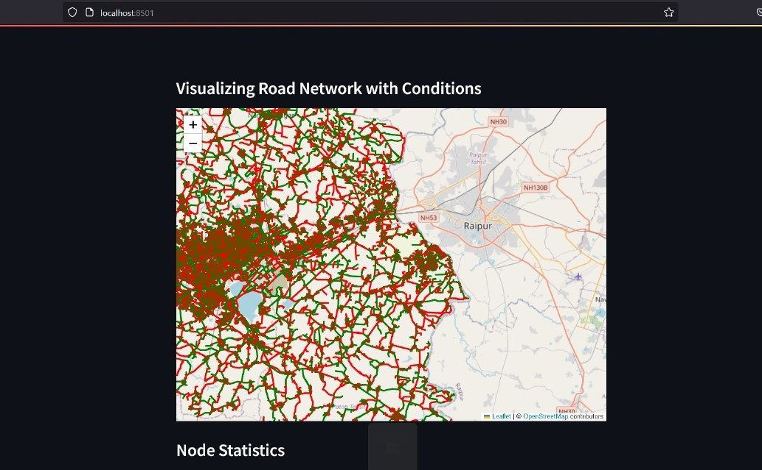
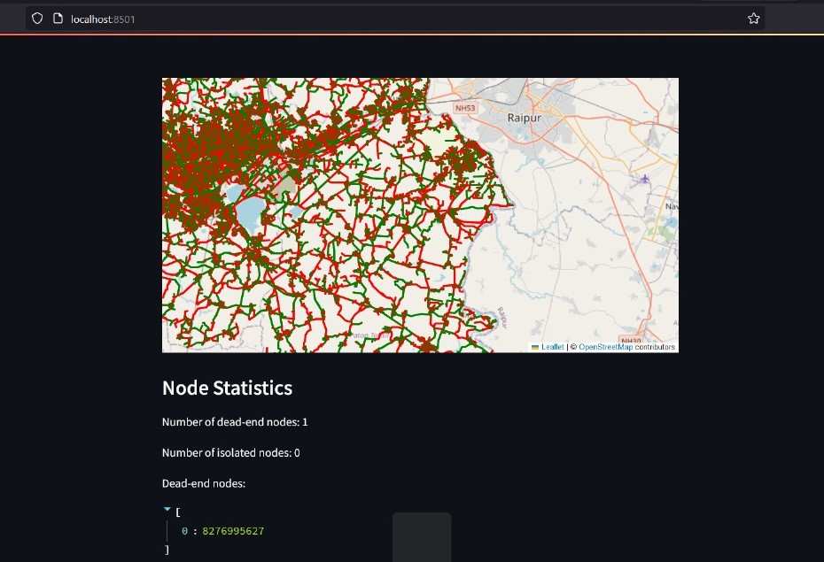
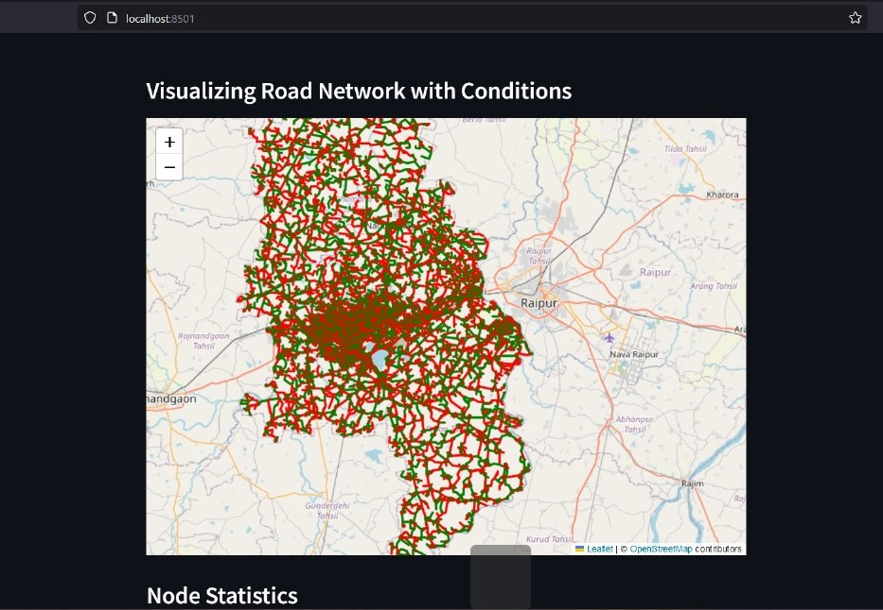
UI Interface

Slide 13
Question & Answer

Slide 14
Thank You

